Slide 1
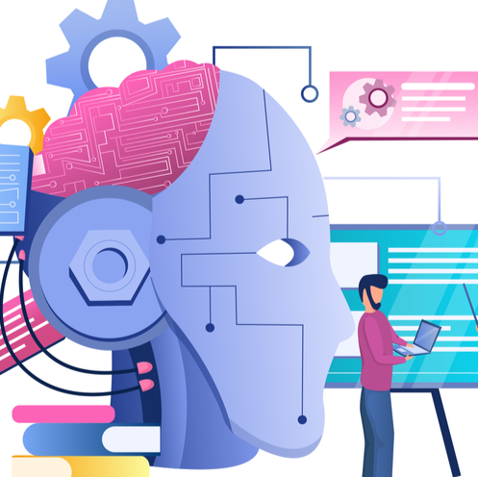
Introduction to Machine Learning
Abdulhameed Yunusa
Lecturer in Computer Science

Slide 2
ML, Data science and AI
Data Science: The field of study that involves collecting, processing, analyzing, and interpreting large amounts of data to extract actionable insights.
Involves statistics, data analysis, and machine learning.
Data Science can be used to build predictive models and discover trends from complex datasets.
Machine Learning (ML): A subset of AI that enables systems to learn from data without being explicitly programmed.
Focuses on building algorithms that can predict outcomes and improve over time.
Relies heavily on data, which is why it intersects with Data Science.
Artificial Intelligence (AI): The broader concept of creating intelligent machines that can perform tasks requiring human intelligence.
Machine learning is a key method used to achieve AI, but AI also encompasses rule-based systems, natural language processing, robotics, and more.

Slide 3
Introduction
Machine Learning (ML) is a subset of artificial intelligence (AI) that gives computers the ability to learn from data and make decisions or predictions without being explicitly programmed.
Instead of writing code to specify every detail of how the program should operate, the machine learning approach allows systems to automatically identify patterns and learn from past experiences, adapting over time as they encounter new data.

Slide 4
Why is Machine Learning Important
Automation of Complex Tasks: Machine learning algorithms can handle complex tasks that are hard to program manually, such as natural language understanding, image recognition, or decision-making.
Scalability: ML systems improve their performance with more data, allowing businesses to analyze large datasets effectively.
Real-time Personalization: It powers real-time personalization and recommendation systems. For example, streaming services like Netflix use ML to recommend shows based on viewing history.
Wide-ranging Impact: From medical diagnostics to self-driving cars, machine learning is transforming industries by enhancing accuracy, efficiency, and performance.

Slide 5
Key concepts in Machine Learning
Understanding machine learning involves grasping several fundamental concepts:
Supervised Learning: In supervised learning, the algorithm is trained on labeled data, meaning each input has a corresponding correct output. The system learns the mapping from inputs to outputs based on this data. Examples include:
Classification (e.g., spam vs. non-spam emails)
Regression (e.g., predicting housing prices)
Unsupervised Learning: Here, the system is trained on data that is not labeled. The goal is to discover hidden patterns or groupings in the data. Examples include:
Clustering (e.g., grouping customers based on purchasing behavior)
Dimensionality Reduction (e.g., simplifying complex datasets to identify key features)
Reinforcement Learning: This is a trial-and-error approach where an agent interacts with an environment, receiving rewards or penalties for actions it takes. Over time, the agent learns to maximize rewards through its behavior. Applications include game-playing AIs (e.g., AlphaGo) and robotics.

Slide 6
Key concepts in ML (cont.d)
Overfitting and Underfitting:
Overfitting occurs when a model learns not just the signal (useful information) in the data but also the noise (irrelevant information), leading to poor generalization on new, unseen data.
Underfitting happens when a model is too simple to capture the underlying patterns in the data, resulting in poor performance even on training data.
Training, Validation, and Testing:
Training Set: The portion of the dataset used to train the model.
Validation Set: Used to tune model hyperparameters and prevent overfitting.
Test Set: A separate set of data used to evaluate the model's performance on unseen data.
Bias-Variance Tradeoff: This is a key consideration when building machine learning models:
Bias refers to errors introduced by overly simplistic models that fail to capture complex patterns (underfitting).
Variance refers to models that are too complex and highly sensitive to noise in the training data (overfitting).

Slide 7
Key concepts in ML (cont.d)
Feature Engineering: The process of selecting and transforming variables in a dataset to improve the performance of machine learning models. Effective feature engineering can significantly impact model accuracy.
Model Evaluation Metrics: Depending on the problem, various metrics are used to evaluate the performance of a model:
Accuracy: The proportion of correct predictions.
Precision, Recall, and F1 Score: Metrics used in classification tasks, especially when dealing with imbalanced datasets.
Mean Squared Error (MSE): Commonly used in regression problems to measure the difference between predicted and actual values.

Slide 8
Applications of ML
1. Healthcare
Early Disease Detection: Machine learning is used in cancer detection through image recognition, analyzing X-rays or MRIs to detect tumors early.
Predictive Analytics: ML helps predict patient outcomes and tailor personalized treatment plans based on medical history and data.
Drug Discovery: ML accelerates drug discovery by predicting how different compounds interact with biological targets.
2. Finance
Fraud Detection: ML analyzes transaction data to detect suspicious patterns, preventing fraud in real-time.
Risk Management: Machine learning models predict financial risks and market trends, enabling better decision-making.
Personalized Banking: ML customizes banking services, such as loan approvals or investment recommendations, based on customer data.
3. Autonomous Vehicles
Object Detection: Machine learning enables vehicles to identify objects (e.g., pedestrians, vehicles) using computer vision.
Navigation: Deep learning helps autonomous vehicles navigate complex environments and make real-time driving decisions.

Slide 9
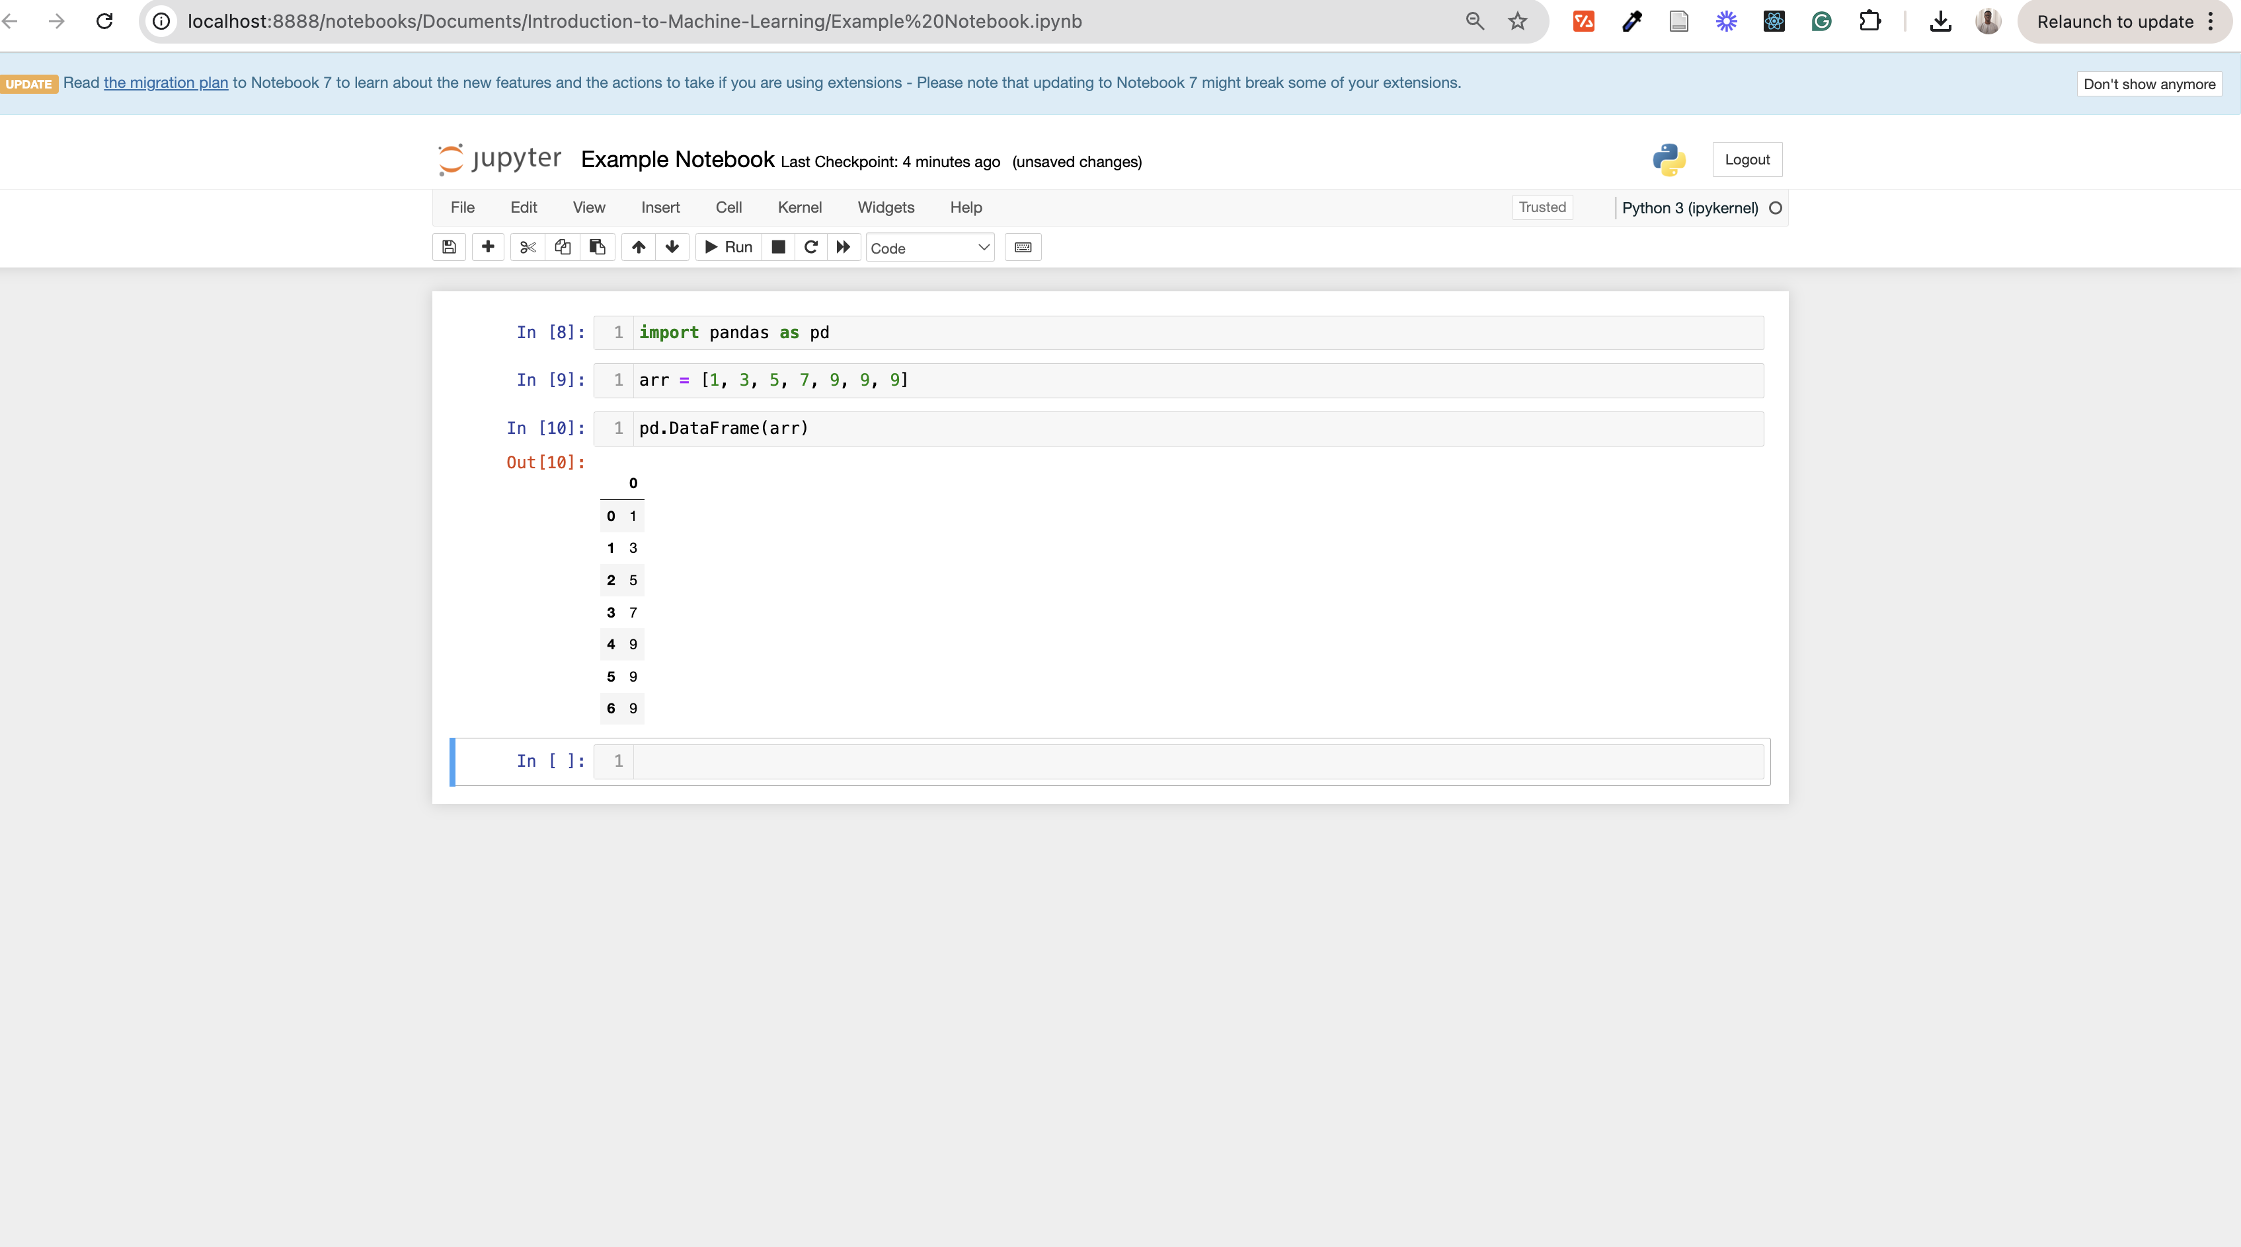
Development Environments (IDE)
Jupyter Lab:
Notebook-style Interface: Jupyter Lab provides an interactive notebook environment where code can be run in cells, allowing users to execute small sections of code and immediately view results. This is particularly useful for experimenting with machine learning models and data analysis.
Data Visualization: It seamlessly integrates code, markdown, and visualizations, making it easy to plot data and charts in the same workspace. This is especially useful for exploring datasets, seeing outputs of ML models, and debugging in real-time.
Ease of Use: Jupyter Lab is beginner-friendly, requiring minimal setup. It's an excellent choice for smaller projects, data exploration, and fast prototyping.

Slide 10
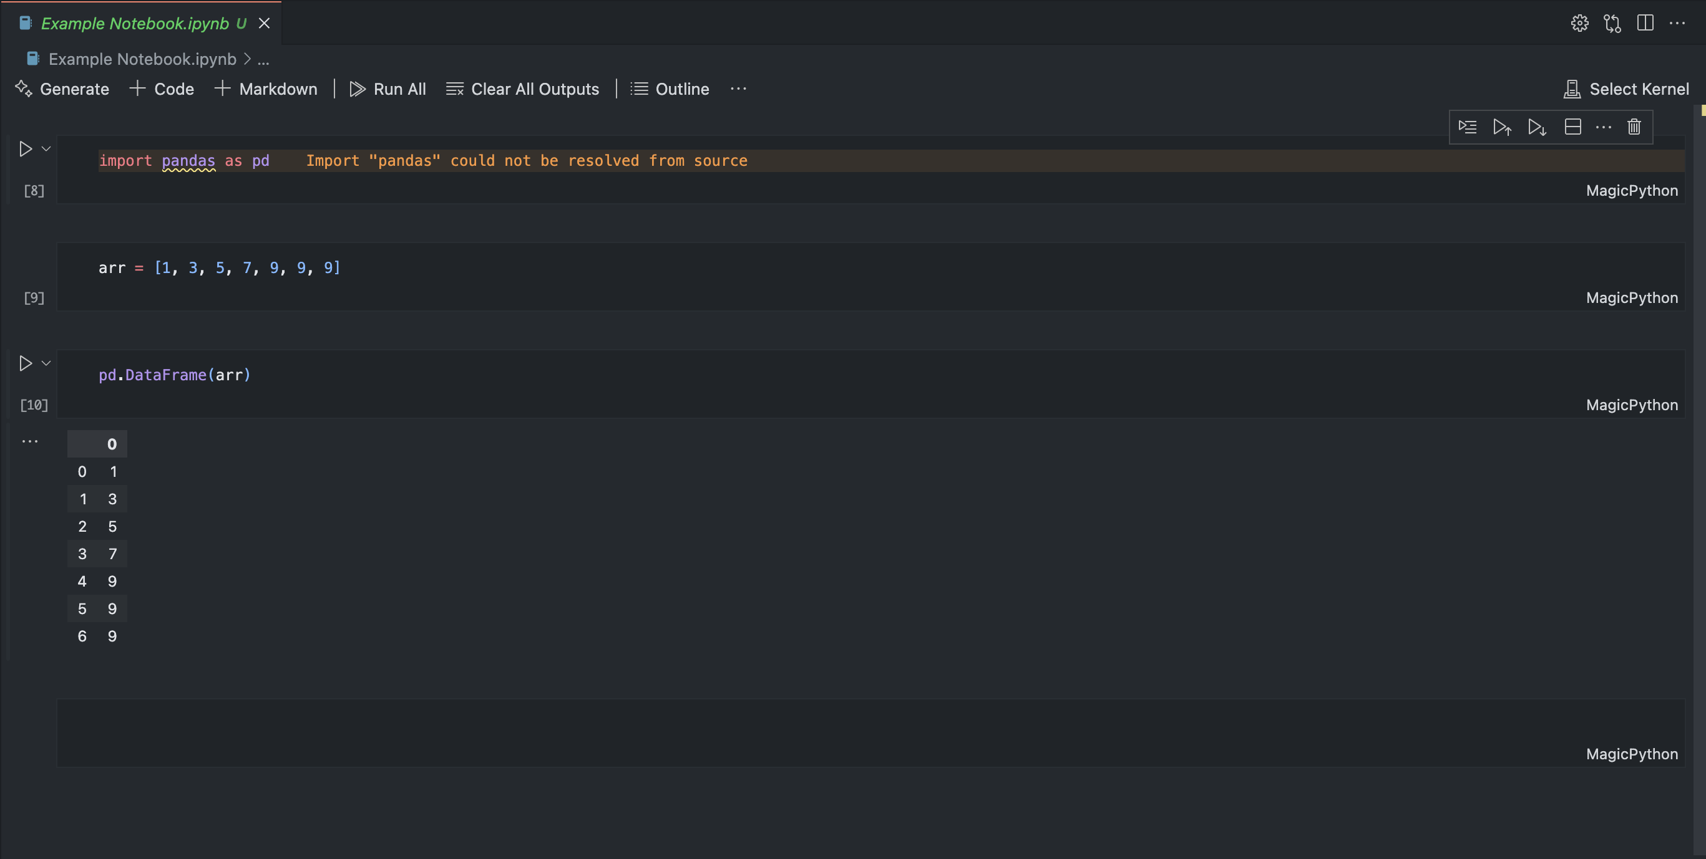
Development Environments (IDE)
Jupyter Lab vs. VSCode for Machine Learning
VSCode:
Full-scale Development: VSCode is a more powerful Integrated Development Environment (IDE) designed for writing and managing large codebases. It supports debugging, version control, extensions, and project management.
Setup Requirements: While VSCode is excellent for larger machine learning projects, it requires more configuration, such as setting up Python environments, adding extensions, and managing packages for data science workflows.
Best for Production-Level Code: It is more suited for advanced developers working on production-level machine learning systems or complex projects that involve collaboration, refactoring, and deployment.

Slide 11
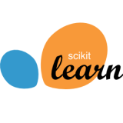



Popular Python ML Libraries
Scikit-learn: A robust library for implementing traditional machine learning models such as regression, classification, and clustering.
TensorFlow and PyTorch: Both frameworks are industry standards for building and training deep neural networks.
Pandas: Essential for data manipulation and preparation, transforming raw datasets into formats suitable for machine learning models.
Matplotlib/Seaborn: Ideal for plotting graphs, understanding data distributions, and drawing insights.
This Photo by Unknown Author is licensed under CC BY-SA-NC
This Photo by Unknown Author is licensed under CC BY-SA
This Photo by Unknown Author is licensed under CC BY-ND
This Photo by Unknown Author is licensed under CC BY

Slide 12
Accessing Datasets
Datasets are key to machine learning, and several platforms like Kaggle provide access to diverse datasets.
Import datasets using pandas.read_csv() or load built-in datasets from libraries like Scikit-learn for practice.
Before training a model, preprocessing steps such as normalising data (scaling values) or dealing with missing values.

Slide 13
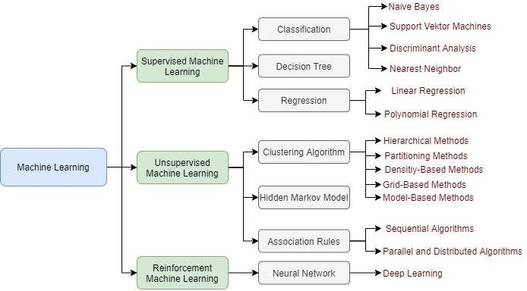
Machine Learning Approaches

Slide 14
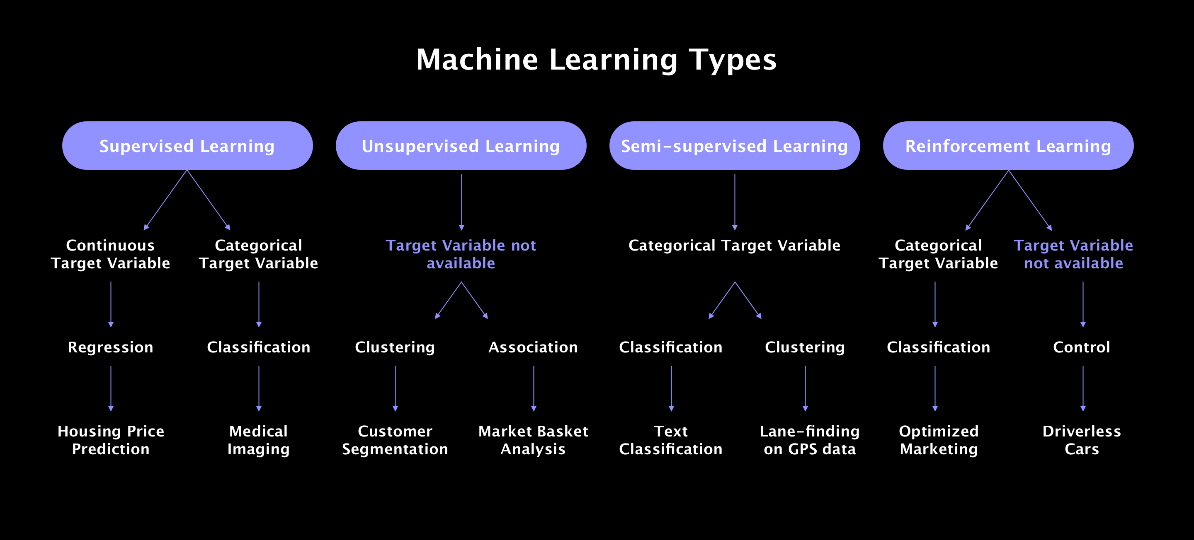
Machine Learning Alogrithms

Slide 15
Choosing the right approach
Small datasets? Use shallow learning.
Complex problems with large datasets? Deep learning works best.
For image classification tasks, start with CNNs, while for simpler tabular data, algorithms like random forests might suffice.

Slide 16
Overview of Large Language Models
Large Language Models (LLMs) like GPT and BERT have revolutionized Natural Language Processing (NLP).
They are pre-trained on vast amounts of text data and can be fine-tuned for specific tasks such as chatbots, translation, and content generation.

Slide 17
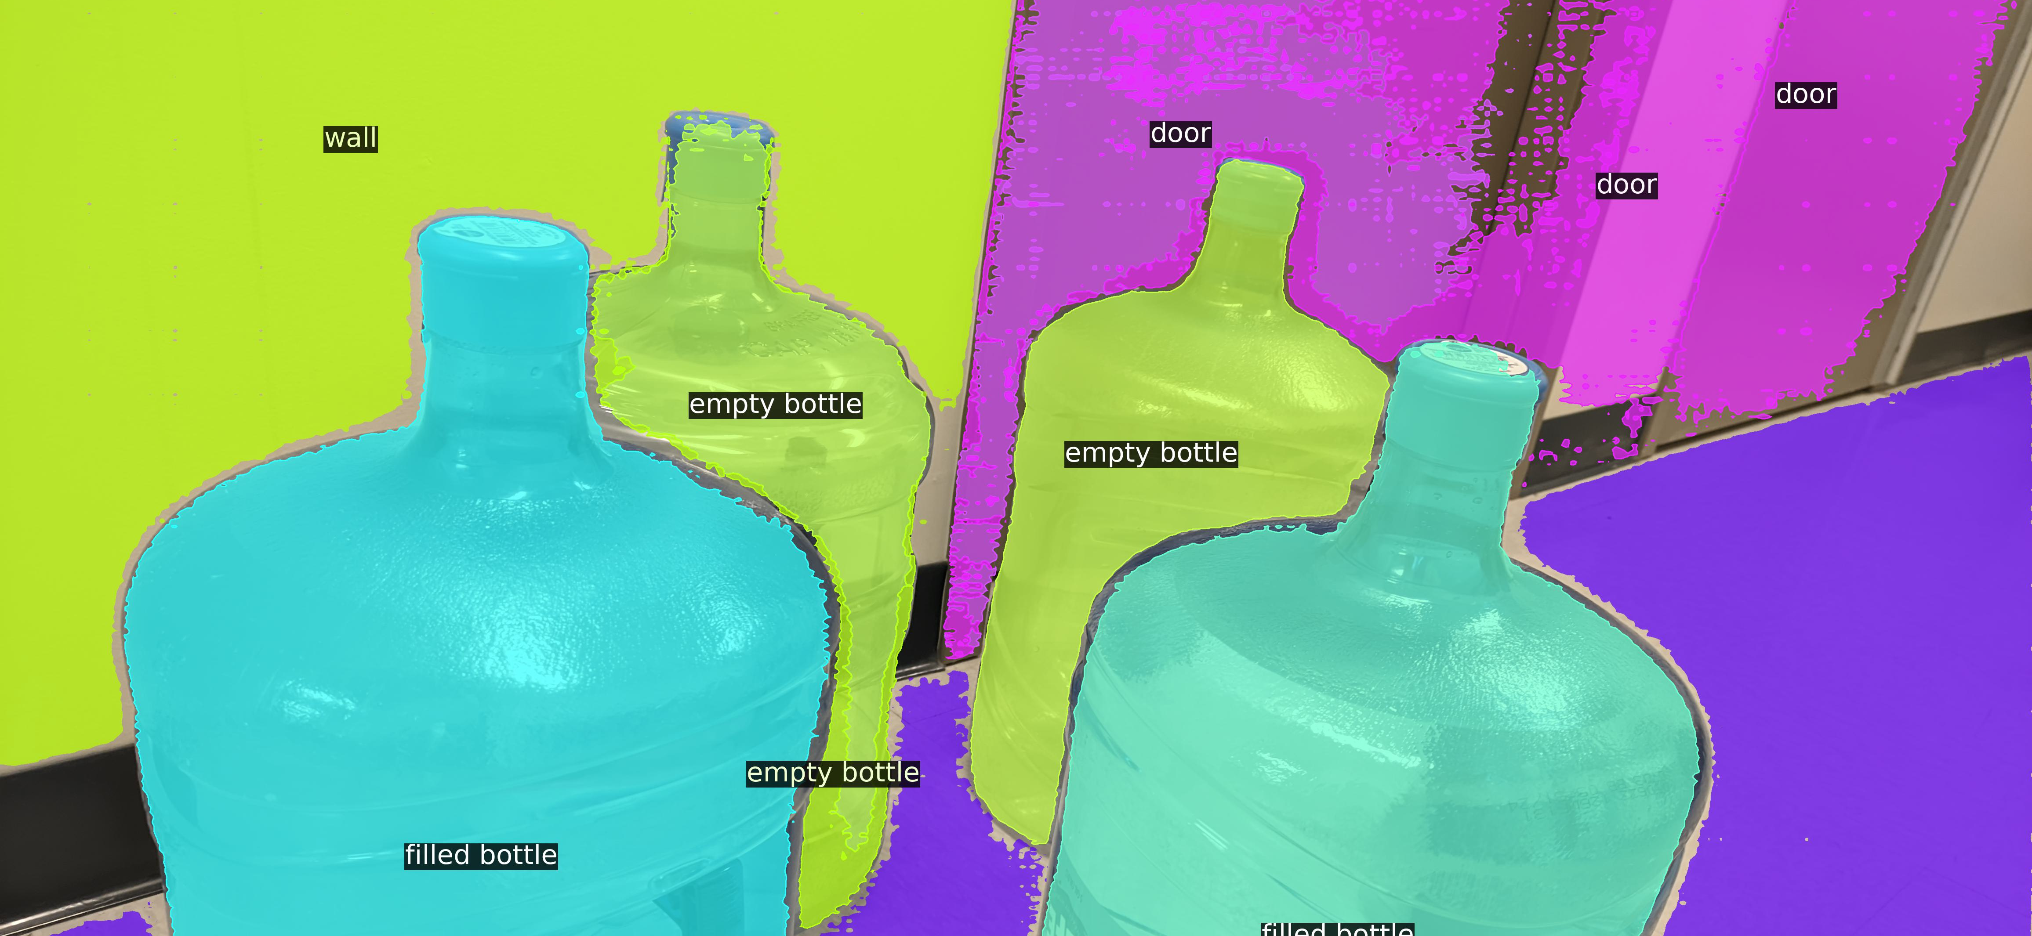
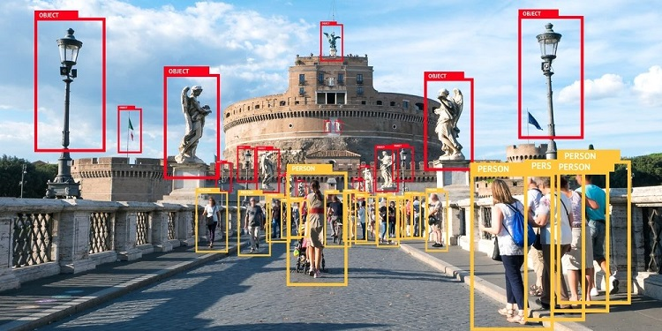
Computer Vision Tasks
Classification, Segmentation, and Object Detection are types of Computer Vision tasks in machine learning. They are used to analyze and interpret visual data, such as images and videos, and serve different purposes in extracting information from visual content:
Classification: Determines the category or label of an entire image (e.g., cat vs. dog in an image).
Segmentation: Breaks down an image into multiple segments, classifying each pixel into a specific category (e.g., identifying different regions of an image, like separating the background from objects).
Object Detection: Identifies and locates multiple objects within an image, drawing bounding boxes around each detected object (e.g., detecting pedestrians, vehicles, or animals in an image).
This Photo by Unknown Author is licensed under CC BY-SA
This Photo by Unknown Author is licensed under CC BY-SA-NC

Slide 18
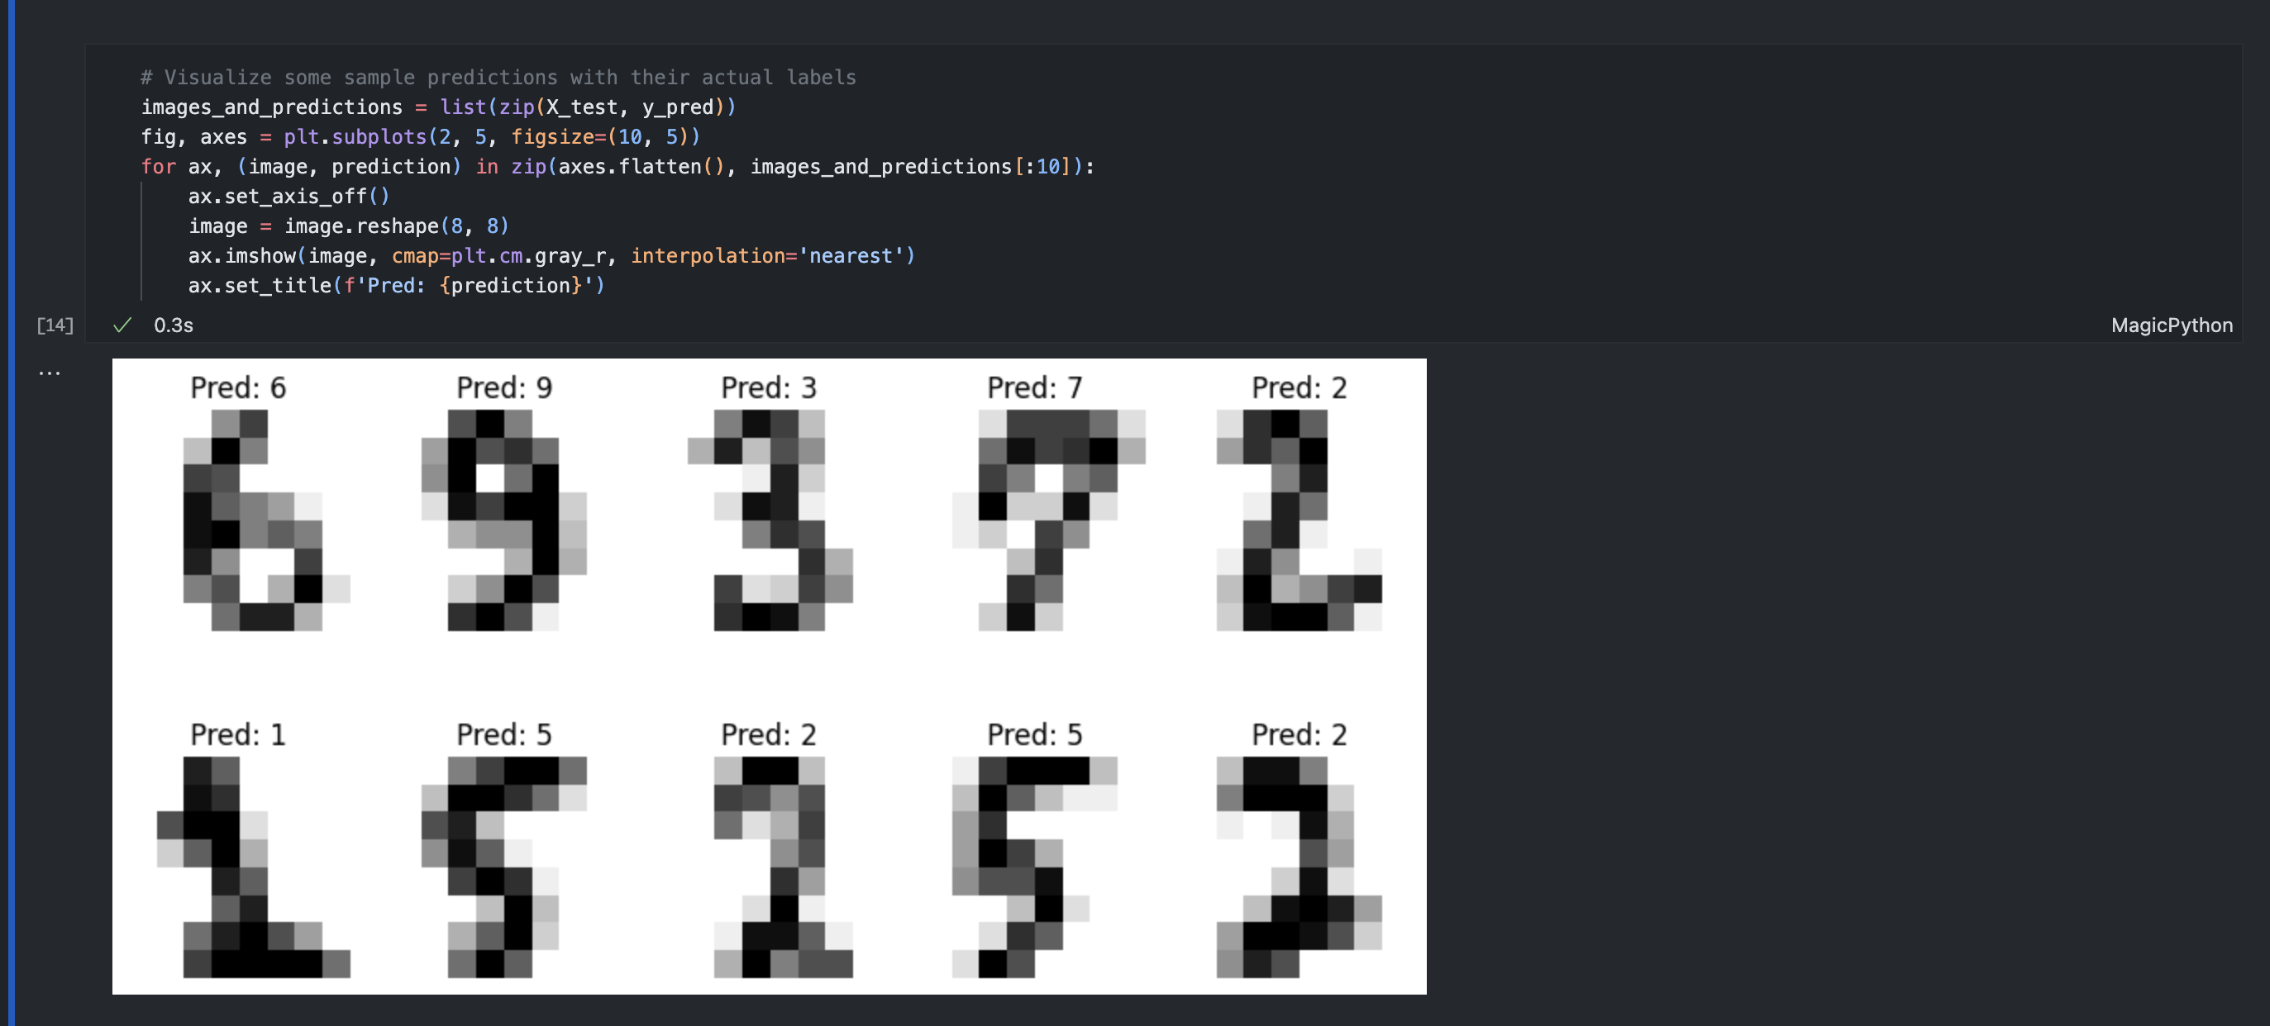
Example 1
Classification: Use Scikit-learn to build a Support Vector Machine (SVM) classifier that identifies handwritten digits from the MNIST dataset.

Slide 19
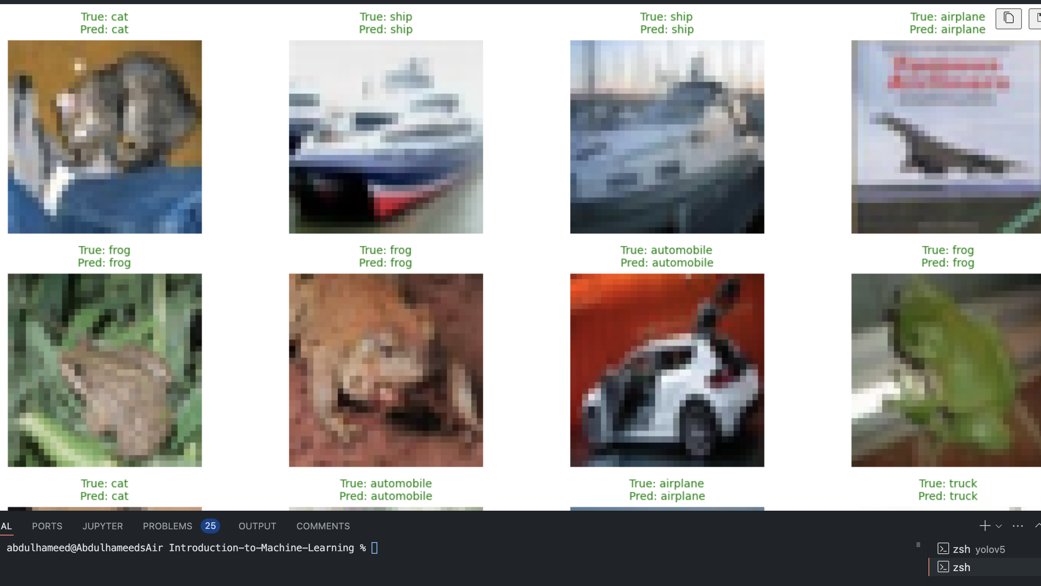
Example 2
Classification: Use Tensor flow to identify objects from cifaas 10 dataset

Slide 20
Problem | Approach to Use | Description
Identify Tumors | Segmentation | Image segmentation techniques, such as U-Net or Mask R-CNN, to detect tumors.
Sentiment Analysis | Text Classification | Classify text as positive, negative, or neutral using models like LSTM, BERT.
Mold Detection | Object Detection | Detect mold in images using object detection models like YOLO, Faster R-CNN.
Handwritten Digit Recognition | Classification | Use models like SVM, CNN, or KNN for recognizing handwritten digits (MNIST).
Spam Email Filtering | Classification | Text classification using Naive Bayes, SVM, or deep learning models (e.g., BERT).
Face Recognition | Identification | Use deep learning models like FaceNet or OpenCV for face recognition.
Speech-to-Text Conversion | Sequence-to-Sequence Learning | Use recurrent neural networks (RNN) or transformers for speech recognition.
Fraud Detection | Anomaly Detection | Use machine learning models like Isolation Forest, Autoencoders, or clustering.
Predict House Prices | Regression | Predict continuous values using models like linear regression, XGBoost, or neural networks.
Self-Driving Car Navigation | Object Detection & Segmentation | Use deep learning models for object detection (YOLO) and road segmentation.
Text Summarization | Text Generation | Use models like transformers (GPT, BART) to generate summaries of text.
Product Recommendation | Collaborative Filtering | Use matrix factorization, k-NN, or deep learning models for recommendations.
Customer Churn Prediction | Classification | Use models like logistic regression, decision trees, or random forests to classify churn.
Protein Structure Prediction | Deep Learning | Use neural networks or AlphaFold to predict 3D protein structures.

